Slide 1

Problem Statement and Team Details
Problem Statement: Smart Doc Checker
Team Name: FutureFusion
Team Leader Name: R.L.S Giridhar
Institute Name: KL UNIVERSITY HYDERABAD
Team Leader Email Id: 2420030171@klh.edu.in

Slide 2
Problem and Solution
Problem: The High Cost of Document Contradictions.
Solution: We have built an intelligent agent that automates this entire process. Our solution is a web-based platform that acts as an automated compliance officer.
Upload: Users upload multiple documents (PDF, DOCX, TXT) through a simple web portal.
Analyze: Our backend agent instantly scans the text, identifies key terms, and compares them across all files.
Report: The system flags every contradiction it finds and presents them in a clear, easy-to-understand report, complete with AI-generated suggestions for resolution.
.

Slide 3
Methodology & Implementation
Our Approach: Full-Stack Separation
Core Logic (Agent’s Brain)
Extract text (PyPDF2, python-docx).
Regex-based entity detection (deadlines, percentages, notice periods).
Compare → Flag contradictions.
API Layer (The Bridge)
Flask REST API (/api/analyze).
Accepts file uploads → Returns JSON results.
Frontend (The Control Panel)
React-based UI.
FileUploader, ResultsDisplay, UsageTracker.
Monetization (Business Engine)
Flexprice billing simulation.
Pay-per-document / Pay-per-report counters.

Slide 4
Technology Stack
Backend
Python (Flask API)
Libraries: PyPDF2, python-docx, Regex, Flask-CORS
Frontend
React (JavaScript)
Libraries: Axios (API requests), CSS3
Development & Deployment
Git (version control)
VS Code + Anaconda environment

Slide 5
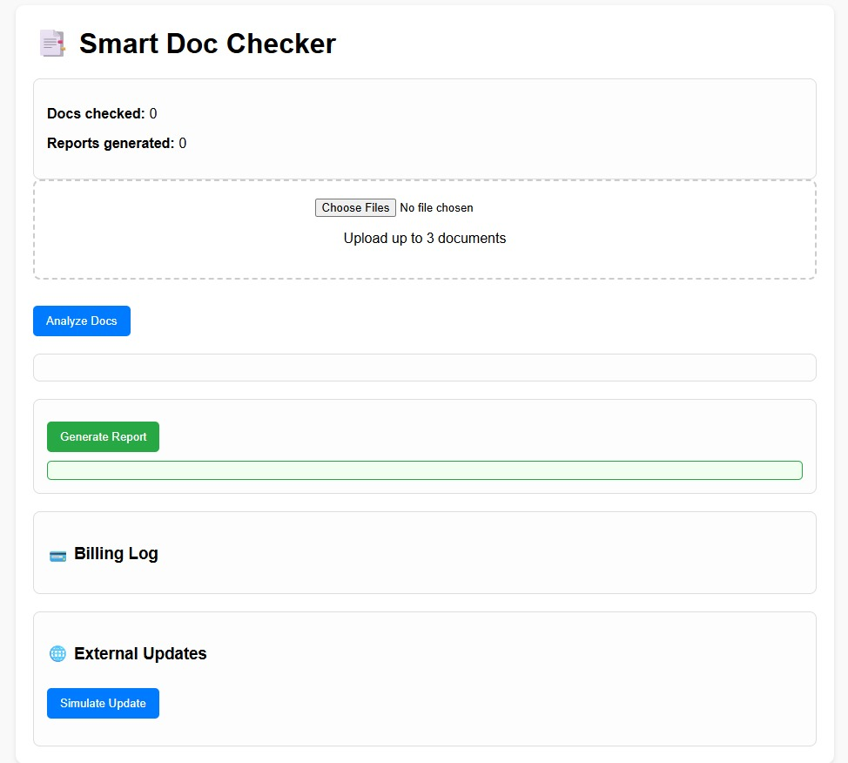
Flowchart & Supporting Images
f
Supporting Images:
Flowchart:
Upload Docs
AI Conflict Checker
Conflict Report
Billing (Flexprice)
External Monitoring (Pathway)
Alerts

Slide 6
Feasibility & Market Use
- High demand in enterprises, colleges, HR departments, startups.
- Prevents legal/operational disputes.
- Subscription model with pay-per-use billing.
- Scalable for multiple organizations and policy monitoring.
- Bonus: Live updates ensure real-time conflict detection.

Slide 7
Conclusion
Smart Doc Checker Agent automates contradiction detection, saves time, prevents disputes, and ensures clarity across documents.
With Flex price billing and Pathway monitoring, it is accurate, cost-efficient, and future-ready.

Slide 8
GITHUB REPO LINK
https://github.com/rgiridhar1008/FutureFusion_smart-doc-checker

